Slide 1
MS2 as a Surrogate For RNA virus detection from Saliva

Slide 2
Three experiments:
Characterizing the RNA assay
Dilution series of MS-2 into the assay
First test in Saliva

Slide 3
The RT- PCR Taqman assay
Primer conc: 0.9 uM
Taqman Probe conc: 0.25 uM
Template is MS-2 virions purchased from Zeptometrix and stored at -20C
Stock is 1e9 pfu/ml = 1e6 pfu/ul
Assays run at 10⁴ pfu/rxn
Assays conditions:
Master mix is Eikon- Promega RT-PCR
95°C, 5 min - open virion
45°C 5 min - RT step
95°C, 3 min - activate Taq
50 cycles
95°C for 1 sec
60°C for 10 sec

Slide 4
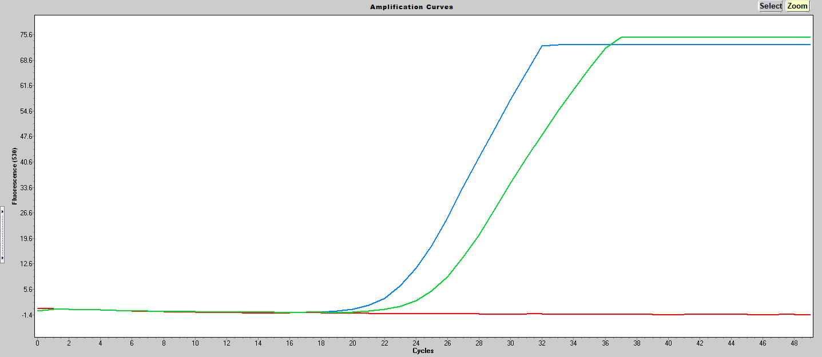
RT Analysis
+RT (23.14)
Packaged RNA (no heat) (25.16)
- RT
Amplification is dependent upon RT and template (not shown)
Virion without heat treatment comes up 2 cycles later than heated virion suggesting that 1/3 of the RNA is not packaged

Slide 5
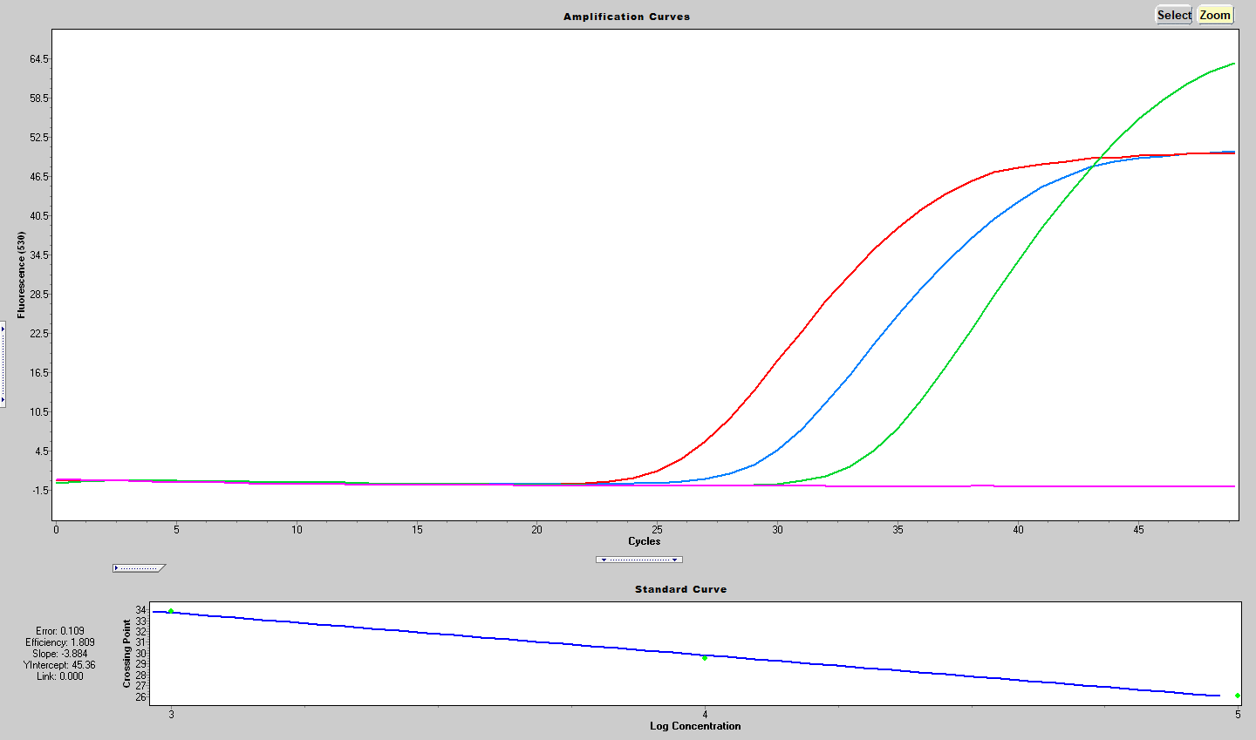
Dilution series of MS-2 int the assay
Efficiency = -1+10^{(-1/slope)} = 1.809
1e3 33.84
1e4 29.56
1e5 26.07
NTC

Slide 6
Saliva
Add saliva to unpackaged RNA (heat template)
Add saliva to packaged RNA (do not heat template)
Positive Control (no saliva)
No RT
After combining saliva and template it was incubated at 37°C for 10 min then heat treated at 95°C for 10 min.

Slide 7
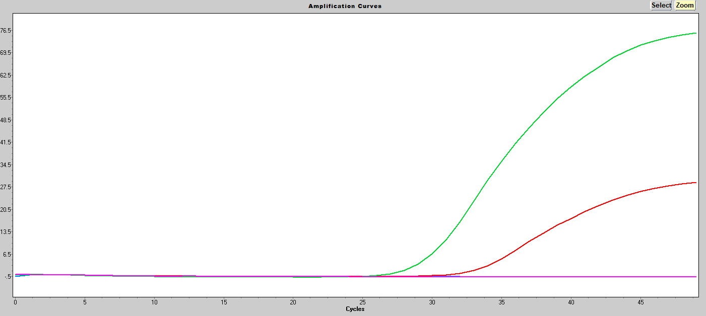
Saliva Analysis
H20 (29.47)
Packaged RNA w/ saliva (33.13)
Unpackaged RNA w/ saliva
-RT
Data is consistent with a model where:
Saliva completely degrades the unpackaged RNA
Saliva only partially degrades packaged RNA.

